Slide 1


TryHackMe is an online cybersecurity training platform. It offers interactive, browser-based labs.The platform is widely used by individuals, educators, and organizations to build skills in ethical hacking, penetration testing, and defensive security.
by Aryan Kushwaha
Ryan

Slide 2


TryHackMe Organization Overview
Founders
Founded
2018
Location
London, United Kingdom
Ben Spring and Ashu Savan

Slide 3

Mission & Purpose
Accessible learning
Make cybersecurity education easy and fun
Hands-on skills
Focus on practical labs and real-world scenarios
Inclusive for all
From beginners to experts
Community growth
Create a strong and helping cybersecurity group

Slide 4

Who Uses TryHackMe?
Students
Professionals
Learning foundational and advanced skills
Upskilling and certifications for career growth
Organizations
Training teams to improve security posture

Slide 5



Training Types & Learning Paths
Learning Paths
Hands-on Labs
Beginner to Expert
Interactive challenges and
virtual environments
Red Teaming
Blue Teaming
Certifications

Slide 6

Platform Growth Visualized

Slide 7


Revenue
• Estimated annual revenue: $15 million
• 10% month-over-month revenue growth

Slide 8

Partnerships & Collaborations
Hack The Box
Joint challenges and community events
Immersive Labs
Shared content development & resources
Educational Institutions
Curriculum integration in universities

Slide 9
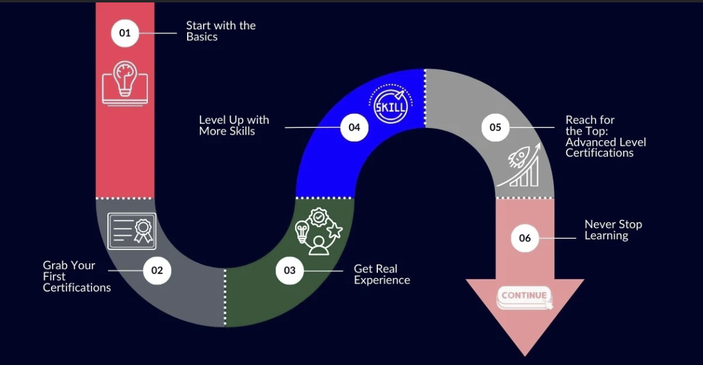
Future RoadMap
Expansion into more
languages and regions
Enhanced features based
on feedback

Slide 10
Conclusion
TryHackMe is a practical, beginner-friendly cybersecurity learning platform offering hands-on labs and structured paths. It supports individual growth, community learning, and making it a valuable tool for real-world cybersecurity skills.

Slide 11



Slide 12


